Slide 1


Virtual Private Networks
And remote access
A Virtual Instructor-led Course Designed Specifically for FDIC Risk Management Examiners
Notes:
https://unsplash.com/photos/b18TRXc8UPQ

Slide 2
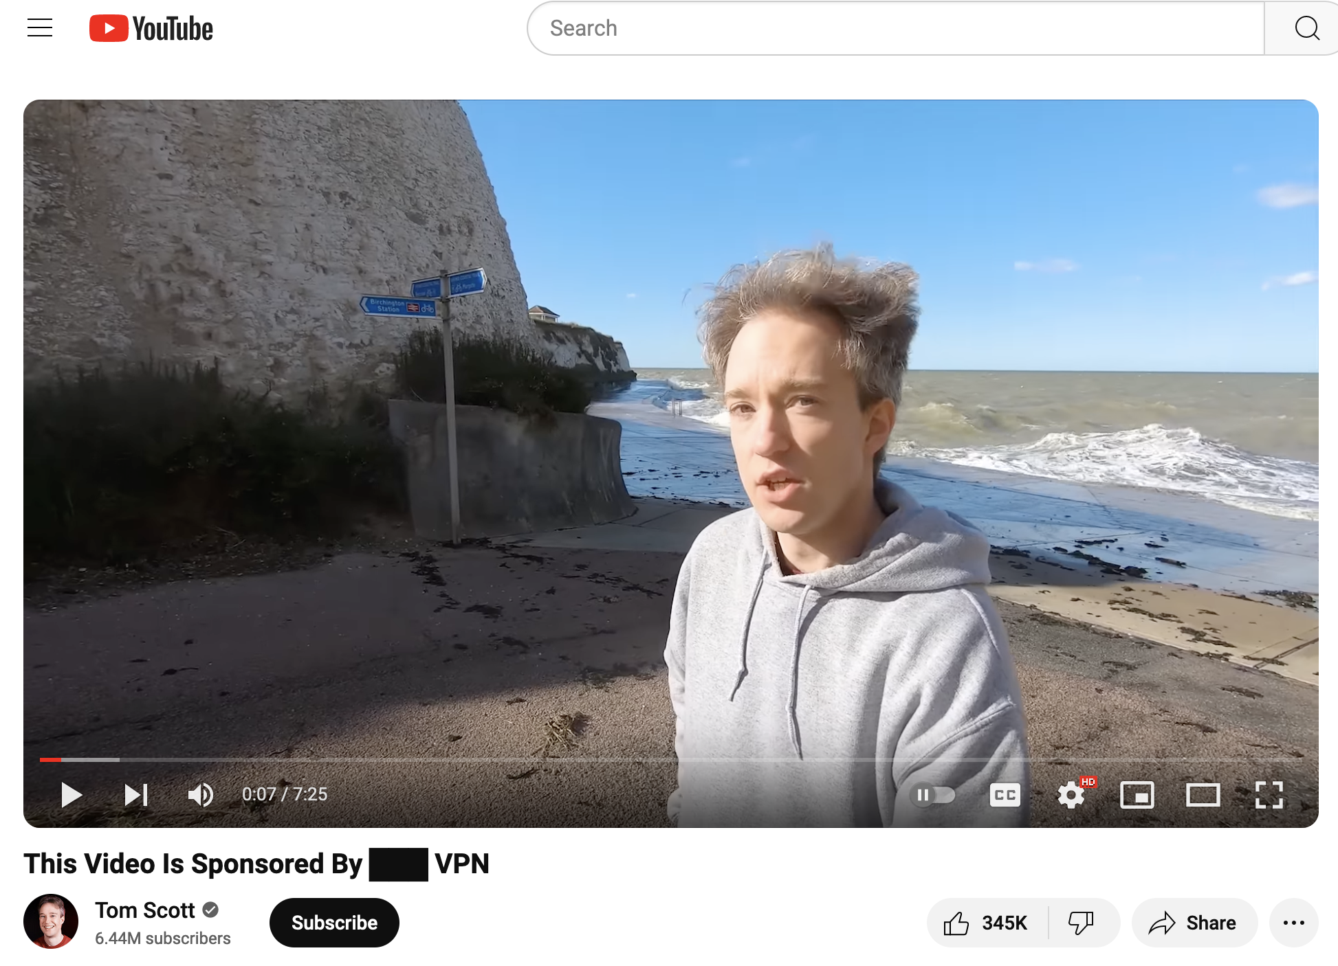
Setting the Stage
Have you watched this video?
Hopefully, you got the link in an email or on our site.
If not, watch it now. It’s only eight minutes long.
What do you think of it?
Correctness of facts?
Value of message?
Relevance to us?
Effect on:
Community banks*?
Bank customers?
Solution providers?
Regulators?
*or any non-enormous bank

Slide 3



What’s a VPN, anyway?
The Internet helps us access resources, but can be:
Difficult to trust
Full of crooks
Slow
Unreliable
Non-compliant
Difficult to use
Confusing

Slide 4

Activity: VPN risks today
I’ll create some 4- or 5-person groups with class participants
In your class group, visit https://www.theregister.com/ or any other site you deem appropriate, and search for “VPN”.
Other sites might include https://thehackernews.com, https://www.securityweek.com/, https://cybernews.com/, or any others that come to mind.
You can also just Google “VPN risks” if you’d like.
Ask yourselves:
What are some risks of VPNs and remote access?
What questions have we just raised that we might try to address?
What is it clear that banks should probably be thinking about here?
Notes:
Click the random group button

Slide 5
Introductions
We have 15 hours together this week, so who’s in the room?
My name is Matt Kolon, I’m a Senior MTS at Hill Associates
I’m a long-time networking and telecom geek
Worked for Cisco, Juniper, and Brocade as well as Hill
Sold and consulted to many banks and financial institutions
In 2005-2017 lived in 香港, 北京, and 东京
Live in Underhill, Vermont where I ski and ride bikes a lot
Please tell us about you!
Where do you live and work?
Who’s your employer and what’s your role?
What do you do for fun?
What would you like to take away from this course?

Slide 6
Program Introduction
Chapter 1

Slide 7

Overall Goals of the Course
Define VPN and explain different types of VPNs and remote access.
Understand why banks need remote access.
Describe VPN architectures and how they’re used.
Understand common VPN weaknesses and risks, including mitigation strategies.
Describe VPNs based on PPTP, IPsec and other protocols.
Discuss how VPNs can be used with firewalls.
Understand the differences between hardware and software VPN implementations.
Review some common VPN products and implementations.
Describe how VPNs are managed and audited.

Slide 8
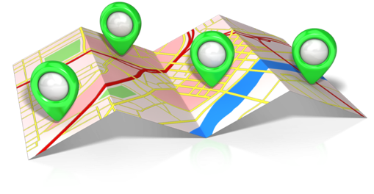
Roadmap to the Class
Today – Context
What does VPN mean to the FDIC?
Theory and protocols of VPNs
Reminder/Review of IP technology
Tomorrow – Technology and Solutions
VPN Building Blocks
VPN Applications and Architectures
VPN Platforms and Products
Day After Tomorrow – Application
VPNs in the Financial Industry
Case Studies and Examples
Notes:
VPN is mostly about privacy, so FACTA, GLBA and other regs.
Ransomware is another important privacy concern

Slide 9
Don’t forget our class web site
https://class.hillvt.com/2025/04/20/VPNRA.html
That’s the link you (hopefully) received last week
Have a look now if you haven’t already
If you have already, what are your thoughts?
I’ll update this page at least daily.
We’ll use it to keep track of “extra” things we talk about
The course book is fine, but this class tends to novel topics
You can return to it for at least a few weeks after our class
You may always ask me later for the links, too

Slide 10
VPNs: The FDIC Context
Chapter 2

Slide 11

Chapter Objectives
Agree on why we’re in a class on VPNs!
Isn’t this a class about banking stuff?
Determine what problems VPNs can solve.
Review what regulations determine banks’ approach to privacy (and VPNs).
Discover the reasons for the sudden importance of VPNs.
Learn the three elements of Information Security.
Consider how we use VPNs in our daily lives today.

Slide 12
What does the FFIEC handbook say?
II.C.15(c) Remote Access
is mostly concerned with:
Locking down
Access control, monitoring, accounting
Authentication
Risk mitigation controls
Calls out and details roles of and differences between:
Remote Access Systems
User or application access over an unsecured network (the internet)
Virtual Private Networks
A secure channel through that unsecured network
In practice, they’re both part of Logical Security, and there is considerable slop between the two areas

Slide 13
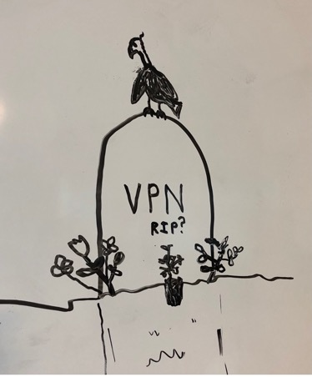
First, some VPN truths
In 2025, VPNs are old technologies!
They were invented when things were different
Apps were in banks
People mostly worked from offices
Data mostly stayed in one place
Mobility was less expected
So new architectures are replacing VPNs
You’ll be learning about ZTNA, SD-WANs, SASE, and more ways the modern world of banking is addressing security, but…
Smaller banks in particular take time to change
VPNs will be around for a long time in many contexts
Go ahead – Google “Death of the VPN”

Slide 14
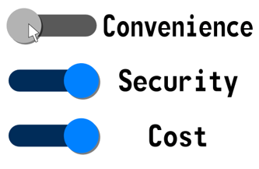
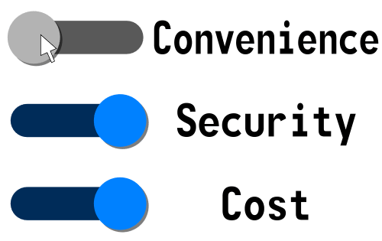
So Then, Why A Class on VPNs?
The world of banking and finance is changing rapidly
Core banking moving to the cloud
Payment systems to compete with e.g. Venmo
Growth of Fintech in general
What else in banking has changed in the last few years?
Banks tend to move deliberately, but must change with the times
Growth
Mergers and acquisitions
Consolidation
Simple competition
There are no easy answers, only middle ground and compromise
How might VPNs be used to address these issues?
This is what we’re going to examine this week
Notes:
You tell me? Why are we here?

Slide 15
The FDIC IG’s 3 Biggest Challenges are all in Tech
Adapting to financial technology innovation.
Strengthening FDIC information security management.
Enhancing oversight of banks’ cybersecurity risks.
Get better at understanding new risks.
Keep pace with the industry.
Improve our own IT security and processes.
The FDIC Inspector General has said these were the FDIC’s top three challenges
Do you agree with his assessments?
Are these FDIC concerns, bank concerns, both, or neither?
Does privacy fit into these challenges? Where?
Notes:
Did you do the reading?
The state of the art says that VPNs are dead already.

Slide 16
A Closer Look at Financial Privacy
There is much law and regulation around Financial Privacy:
Fair Credit Reporting Act (FCRA, 1970) and Fair and Accurate Credit Transactions Act (FACTA, 2003)
Right to Financial Privacy Act (RFPA, 1978)
Gramm-Leach-Bliley Act (GLBA, 1999)
These and many other acts and laws have provisions protecting privacy of financial information
They also have provisions allowing access in some circumstances
GLBA in particular calls out the need for banks to have:
Privacy policies that customers know about.
Exceptions called out for customers.
The ability for customers to opt-out of (some) exceptions.
These rules are important, but they don’t cover what 3rd party bad actors might do!
It’s difficult to make regulations for the bad guys.
All you can do is try to keep them from ever getting your data.

Slide 17
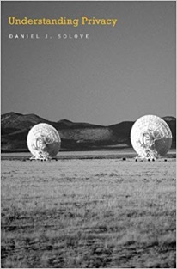
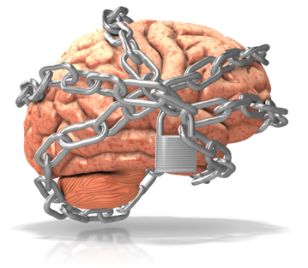
What Are We Hiding?
Definitions of privacy vary widely; it’s “a concept in disarray.”
Yet we all probably agree that banks require privacy to serve their customers.
What does Virtual Private Network mean to you?
Does the word “virtual” indicate that what follows is a lie?
But isn’t a mortgage “virtual home ownership” or a loan “virtual wealth”?
How private could virtually private be?
Why do banks need VPNs?
Why don’t they just have utterly, completely, perfectly private networks?
Banks didn’t have VPNs before about 2000. Why not?
Google “Best VPN” right now, what do you see?
There are a zillion VPN products in many different categories
This class is all about making sense of this situation
How can VPNs help address the IG’s challenges?
Notes:
There is often a big gap between reality and how we represent things.
Nord vpn, tunnelbear, privatevpn, expressvpn, protonvpn, cyberghost
there’s also TOR
VPNs help the IG on the FDIC network side, but also in adjusting to new fintech and oversight (this class)

Slide 18

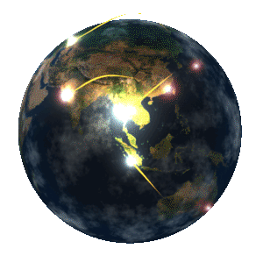
What do VPNs provide?
VPNs secure information in transit
Information Security consists of three elements:
Confidentiality: Prevent unauthorized disclosure
Integrity: Maintain accuracy and completeness
Availability: It’s available when you need it
Other services or capabilities of some VPNs
Authentication
Access control
Performance improvement
Non-repudiation
Visibility/Statistics/Data
Access/use Logs
What else might a VPN do for you?
Notes:
What else? Location privacy, identity privacy/hiding

Slide 19
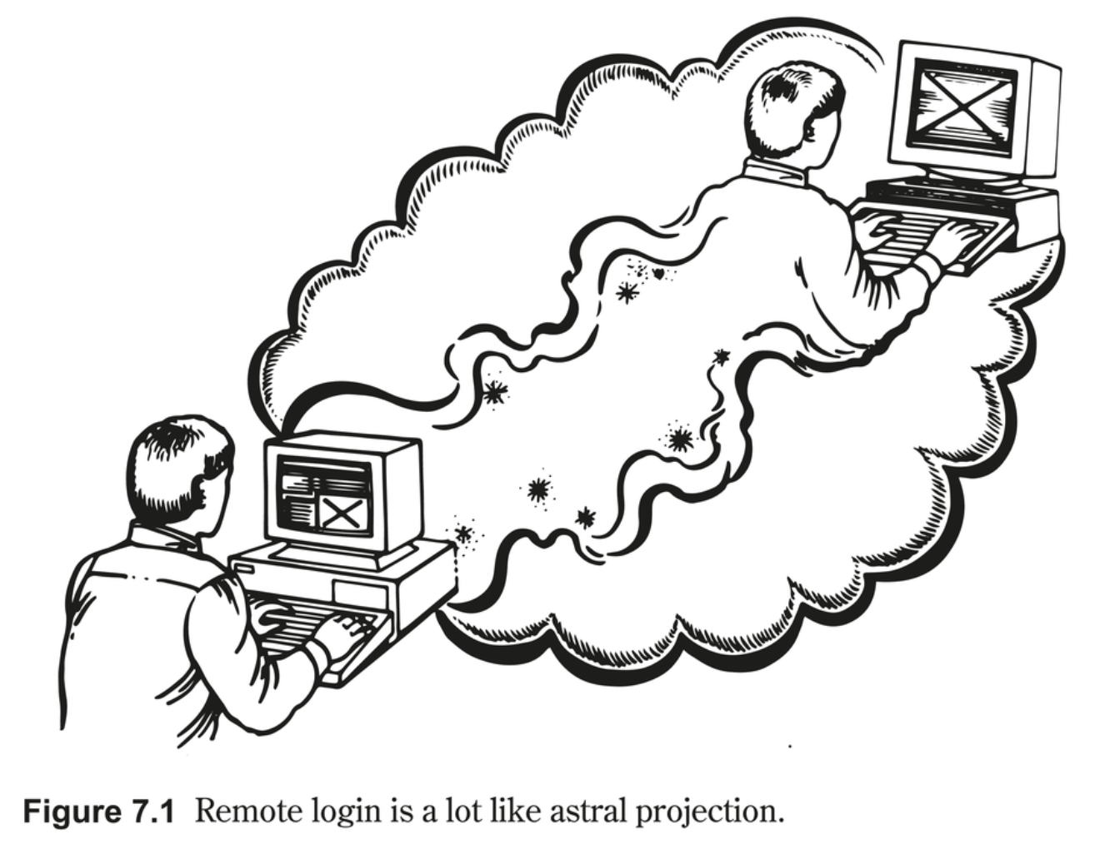
What is Remote Access?
Access to what?
Data?
Systems?
Applications?
What kind of platforms are used?
Integrated into applications?
Standalone?
RAaaS?
Outsourced?
How has this capability changed over time?

Slide 20


Notable VPN Failures and Weaknesses
People use VPNs for many different reasons
To access content they could not otherwise access.
To evade censorship.
To hide their physical and network location (here’s a little demo.)
What are the consequences of a failure?
Confusion: Internet VPN vs MPLS VPN vs SSL VPN vs …
Three entirely different solutions, and that’s just a start.
Do the banks you examine understand what their VPNs do?
Vulnerabilities
Powerful people and agencies
Poor Key Handling
Weak Encryption/Short Keys
Authentication Bypass
Old Protocols
VPN Malware
Single-layer Auth, or other Security Theater
Weaponized HTTPS
Surely others!
Notes:
Story about living in China and the GFW
What did you think of the Forbes article?

Slide 21

Non-VPN “privacy” in an interconnected world
Separation versus Obfuscation
Which is better?
Might you need both?
Is there any truly “private” network?
How private is the FDIC network?
Almost everything is connected somehow
How can we obtain privacy given this fact?
Actual privacy
Virtual privacy
What’s the difference?
VPNs of one kind or another are a critical part of modern privacy
Internet
T
VZ
CHTR

Slide 22
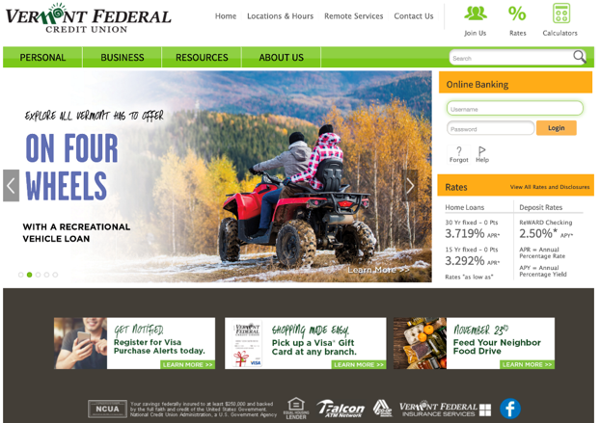
Discuss: VPNs in daily use
What VPNs do you use, and when?
At work and for personal use
Do you intentionally use a VPN, or does it “just happen”?
What about the banks and agencies you deal with?
Between themselves
Between they and their customers and/or service providers
What FDIC regulations discuss and govern VPNs?
What agencies do these come from?
Are VPNs in the FFIEC handbook?
Does anyone have the “moral authority” here?
VPNs often fade into the background
Good if you’re a user (maybe).
Tougher if you’re looking for risks.
Hey, who’s this?
Notes:
II.C.15(c) Remote Access

Slide 23
Activity: VPNs and Remote Access in Banks
You know much more than the instructor does about banking regulations.
So, in your group, please educate him and the room:
What does the FDIC expect banks to do to protect privacy of:
Customers
Accounts
Transactions
What else?
How are banks expected to know your expectations?
How can they assert or prove conformance?
As an examiner, what can you do to ease this process?
With what you know (perhaps informed by what you’ve learned so far), how would VPNs affect your consideration of these things?
Notes:
Click the random group button

Slide 24

Chapter Summary Questions
What problems can VPNs help solve?
What regulations govern information privacy for banks?
Why have VPNs only existed for the last 20 years or so?
What are the three elements of Information Security?
What are your biggest uses of VPNs today?
Notes:
Confidentiality, integrity, availability

Slide 25
TCP/IP Review, Reminder, Refresh
Chapter 3

Slide 26

Chapter Objectives
Consider the OSI reference model and how it describes network functions.
Remember the supporting protocols of VPNs and their strengths and weaknesses.
Understand encapsulation and tunneling and how they enable VPN features.
Consider the use of software for networking problems like VPNs.

Slide 27
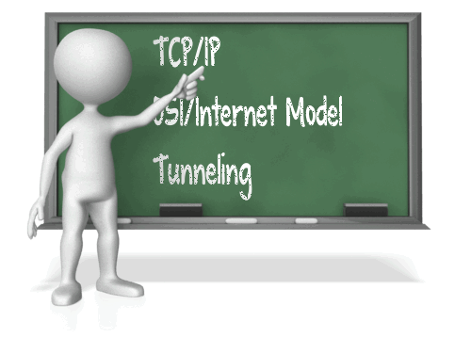
Here we go again…
You might have learned this chapter’s material in the Intro or Firewalls courses, or have come across it otherwise, particularly in the case of IT exams.
Hopefully this is a review, but let’s make sure we have some concepts down that are fundamental to understanding VPNs and their underlay networks.
We can go as fast or as slowly as you like.
Without a solid knowledge of these basics, this class will be tough.
In short, it’s important to know:
The basics of layers and the OSI model.
The most important protocol examples and how they work.
Encapsulation and tunneling as operations.
Where in the network VPNs usually live.

Slide 28
Layers and the OSI model
How much do you remember of this? Don’t worry!
We only need a few parts to discuss VPNs
Applications use the network by talking to the application layer
In “typical” use, from the user point of view, that’s all
Systems are preconfigured to handle the rest
Each layer has its own responsibilities
At least in theory…
But VPN operations change this somewhat
How that works is something we’ll discuss in detail later
For now a rough idea of this is all we need
Application
Presentation
Session
Transport
Network
Data Link
Physical
28

Slide 29
A Closer Look at the OSI Layers
More software
Application
Information Semantics (email, web, voice)
Computers, SD-WAN
Presentation
Information syntax (compression, encryption)
Session
Dialogue/session control (logon, checkpointing)
Firewalls
More hardware
Transport
End-to-end correctness (sequencing, loss)
Routers
Network
Routing (addressing, congestion control)
Data Link
Node-to-node correctness (access, bit errors)
Switches
Physical
Bit transmission (distance, speed, medium)

Slide 30
Moving Through the Layers
DATA
Application
Application
AH
DATA
DATA
Presentation
Presentation
PH
AH
DATA
AH
DATA
Session
Session
SH
PH
AH
DATA
PH
AH
DATA
Transport
Transport
TH
SH
PH
AH
DATA
SH
PH
AH
DATA
Network
Network
NH
TH
SH
PH
AH
DATA
TH
SH
PH
AH
DATA
Data Link
Data Link
DLH
NH
TH
SH
PH
AH
DATA
DLT
NH
TH
SH
PH
AH
DATA
Physical
Physical

Slide 31
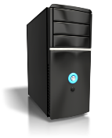

A Simpler View – the Internet Model
Application
Application
Transport
Transport
Internet
Internet
Internet
Network Interface
Network Interface
Network Interface
Network Interface

Slide 32

Encapsulation and Tunneling
Layers have a “natural” encapsulation order as you saw on the last slide
We can create special services by changing this order
What if a “smart box” treated an Ethernet frame like a TCP payload?
Or if it moved a Wi-Fi frame from AP to AP over UDP?
What problems might this cause?
What services would it make possible?
Messing with the layers this way is broadly referred to as “tunneling.”
Tunneling is used often in VPNs, but also in Ethernet vLANs and MPLS.
32

Slide 33
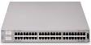

Your basic switched Ethernet
Application
Presentation
Ethernet Switch
Session
Transport
Client
Server
Ethernet
Probably IP packets but we don’t really care
Ethernet
Network
Ethernet
Ethernet
Ethernet
Ethernet
Ethernet
Ethernet
Remember it’s all layer 2!
Data Link
Physical
Notes:
Let’s begin with a simple connectivity example. Here we have a client and a server who want to talk. Luckily for them, they're in the same building, or at least on the same campus, so we can plug them into an Ethernet switch, and they can send frames to each other. Those frames are probably carrying IP packets, but for this discussion, we don't really care about the payload. This is very simple to discuss because all layer 2, with no routing required. It's also a small private network, so we're not too concerned about security.

Slide 34
Two Ethernet switches and a WAN
MPLS or Ethernet WAN
Application
Presentation
Session
Ethernet Switch
Ethernet Switch
Transport
Client
Server
Ethernet
Probably IP packets but we don’t really care
Ethernet
Network
Ethernet
Ethernet
Ethernet
Ethernet
Ethernet
Ethernet
Remember it’s still all layer 2!
Data Link
Physical
Notes:
What needs to change if the client and server are in say, LA and New York? Well, if they can be connected by a private WAN, such as MPLS or Carrier Ethernet, not much! After all, those services are similar to, or the same as, the Ethernet the computers are plugged into, and connect via their own Ethernet switches. In fact, the WAN itself in this example is just a larger version of the single-switch network we just left. So when the client sends Ethernet frames, they just flow across the cables the same way, with the switches just forwarding them down the pike to the server. And they still probalby carry IP. No big whoop, because (say it with me now) it's all layer 2! And yes, because it's a private WAN, there's still no enormous concern about privacy and security.

Slide 35


Theoretical VPN Tunneling Example
Internet
Application
Presentation
Session
Magic VPN Box
(Authorized, Encrypted TCP Connection)
Magic VPN Box
Transport
Client
Server
Ethernet
Probably IP packets but we don’t really care
Ethernet
Network
Ethernet
Ethernet
Ethernet
Ethernet
Ethernet
Ethernet
TCP
Data Link
IP
Ethernet
CE
Ethernet
WDM
MPLS
Ethernet
Physical
Definitely not still all layer 2!
Notes:
But uh oh, here's a different kettle of fish altogether. Now we're trying to connect these distant computers using the internet. Maybe we didn't want to pay for a private WAN, or one wasn't available where we are. So we plug into the internet, with all it's awesomeness and horrors. Since the internet is a layer 3 network, meaning it speaks IP - the internet protocol - we can't just use switches anymore. At the very least, we need routers, and because we want this VPN, we actually need more than that, we need a router with some special sauce, which I'll call a magic VPN box. What these things can do is to find each other and build an authorized, encrypted TCP connection between themselves. This is what we now know we can call a "VPN tunnel". Whatever goes in one end will be safely carried to the other.
We don't know what the infrastructure of the internet will be at any given point, it's likely to be a crazy mix of different L2 networks like these. But we do know they will work together to carry IP packets hop-by-hop to the other magic VPN box. We also know that IP will carry TCP. So now we have a way to send whatever we want between these two computers, right? What do we want to send?
Well, it could be anything, but before you get too excited about payments or cat pictures, remember that our client and server wanted a direct Ethernet connection. Maybe their application requires it, or its just an old one that expected local connections. We're on opposite sides of the country now with only the internet between us, but we do have that TCP tunnel between the magic VPN boxes, to which each computer is connected. Why can't we use it to carry...Ethernet frames? It's weird, but it works, and that's exactly what a modern VPN using tunneling is. It just moves the layers around and uses special software to make it happen. Now our two computers can act as through they're directly connected via Ethernet, and those Ethernet frames look just like the ones we began with, and we still don’t really care what they’re carrying. The only price to pay here is that it’s complex, but that’s where software comes in, because these intelligent VPN systems are able to automate and ease the provisioning of VPN services like these.

Slide 36
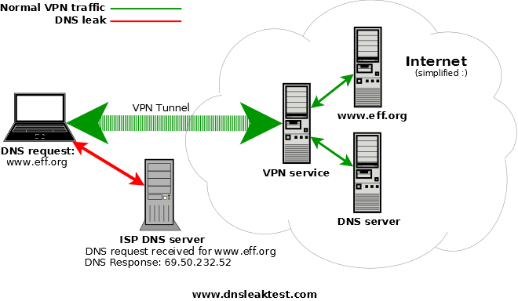
DNS’ Critical Role
The Domain Name System
The Internet can’t work without DNS
DNS can itself use a VPN tunnel.
But to what DNS server?
Is that server known?
What ensures it does?
If the DNS goes around the VPN, then:
The DNS may still work, but:
The “outside” DNS knows who you’re looking for.
Your behavior isn’t private.

Slide 37
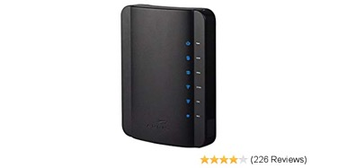


Remember, Software Ate the World
In these and other diagrams, VPNs and their endpoints are often shown as boxes.
Something like this or this or this
These days, VPN functions live in many places:
Embedded in various machines like ATMs
As part of software or firmware, whether operating system or add-on, client or server
Inside a firewall, UTM platform, or other security appliance.
Downloaded from, or hosted in, the cloud.
Bank (and other) network diagrams are often distressingly vague about where various functions are located, and how they connect
It’s very important to know “where” the VPN begins and ends, and how it protects the data entrusted to it

Slide 38
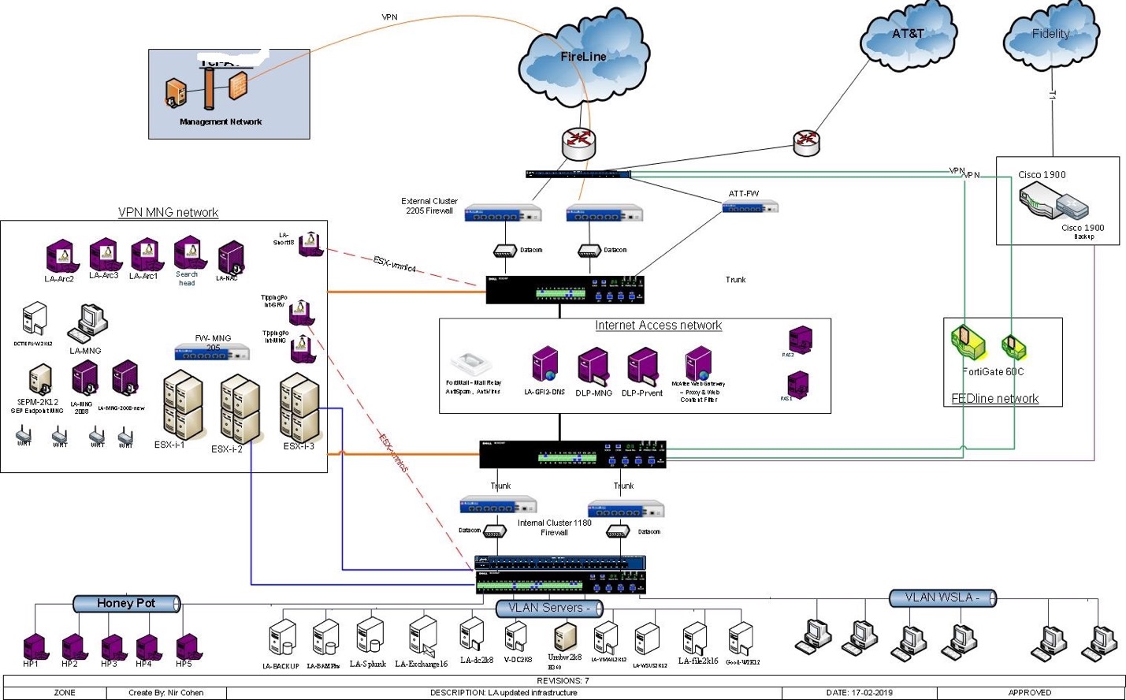
Find the VPNs I

Slide 39
Find the VPNs II

Slide 40
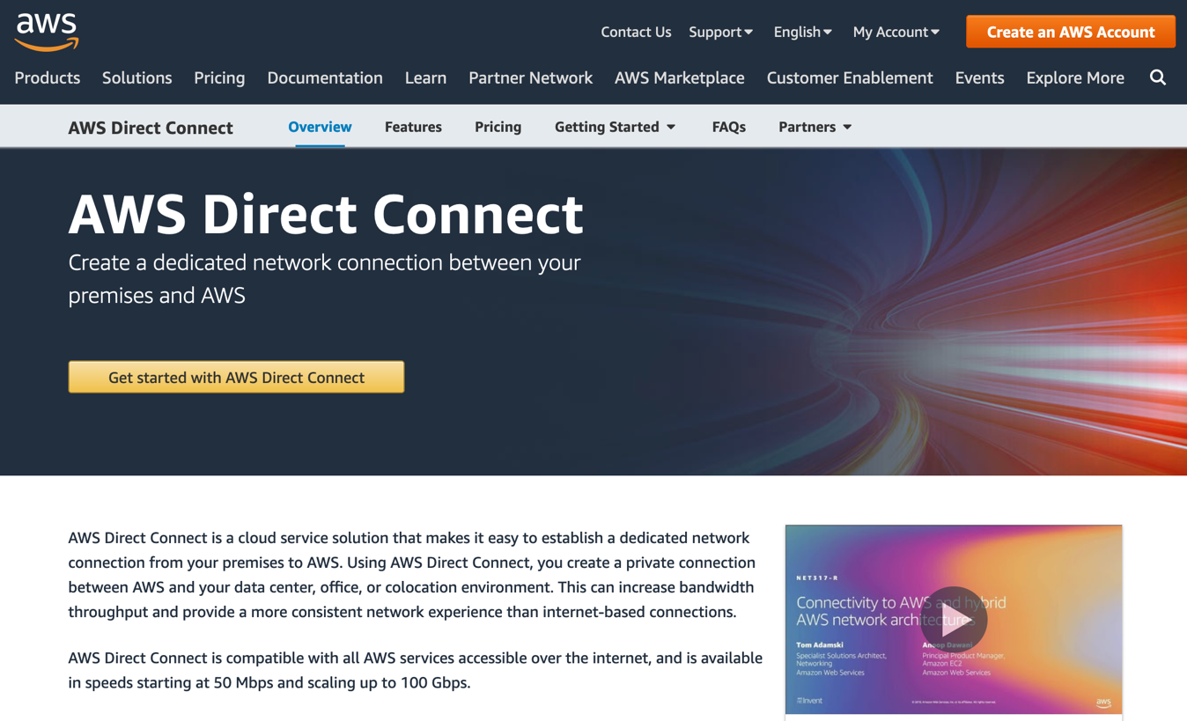
Not a VPN, but what do you call this?
Notes:
https://aws.amazon.com/directconnect/
https://aws.amazon.com/directconnect/?nc=sn&loc=1

Slide 41
Chapter Summary Questions
How and why do the OSI and Internet reference models describe network functions?
Name some central protocols and layers of VPNs operations.
How do encapsulation and tunneling differ in terms of models, and their use in VPN network solutions?
How is the rise of “software enabled” functions and solutions changing the world of security and IT?

Slide 42
Review of Monday
VPN context
Banking problems that VPNs can address
Tech advancements where VPNs help
Networking review
Layers, encapsulation, and tunneling
DNS is so important – review
Article Review
Any VPN news today?
Any ideas for questions or risk regarding VPNs or Remote Access?
What did you think of the Tom Scott video?

Slide 43
Back to DNS for a moment
When you click on that link > DNS!
When you visit a site > DNS!
When you connect to your VPN server > DNS!
Everything we access is obscured by HTML and DNS
You see the link, but not the code, unless you look
It’s messy and hard to read, and therefore easy to spoof
Right now, there are two parts to the concern:
Inspection addresses the HTML problem (but requires training)
Certificates address the DNS problem (and is a bit of hassle)

Slide 44


Domain Name System Exposed
Great now I can contact them
I would like to get OutsideBank.com
Who can I ask?
TLD DNS Servers
We know who to ask
What is OutsideBank.com’s
IP address?
Ask the DNS server at this IP address
What is OutsideBank.com’s IP address?
Local DNS
Answer
Range of information in DNS Databases
A records
PTR records
MX records
CNAME records
TXT records
I know MyBank.com
Answer
Other Local DNS
Evil DNS
We know OutsideBank.com, and many others.
I’m bad.

Slide 45
VPN Building Blocks
Chapter 4

Slide 46

Chapter Objectives
Distinguish between proxy servers and private network elements.
Consider authentication, authorization, and accounting (“Triple-A”).
Learn the basic operation of common AAA protocols.
Learn about digital IDs in the form of Certificates, and how they’re used.
Understand the essential elements of encryption.
Consider encryption keys and methods for distributing them.
Learn the basics of the Public Key Infrastructure.
Consider the vulnerability of today’s encryption, now and in the future.

Slide 47
VPN Problems that need solving
“Triple-A” or AAA
Authentication
Authorization
Accounting
Encryption
Cipher
Mechanism / Network
Related concepts
Location
Performance
Compliance
“Are the parties at each end who they claim to be, and what kind of permissions do they have? We must keep records of this, too!”
“Is the data safe from eavesdropping while in transit?”
“How else might a VPN help solve the general problems of remote networking?”
47

Slide 48
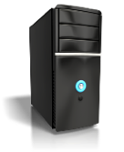
VPNs and Proxies
Proxies (or proxy servers) help hide your location or identity
Useful for some purposes.
Some degree of anonymity
No encryption, so no real security
Often associated with a single protocol
HTTP proxies
SOCKS proxies
VPNs both hide endpoints and secure traffic
Not all VPNs services are end-to-end
They can, however, help to secure an E2E session
More to come on this as we move along
Client
Proxy Server
Resource
Clear
Clear
Client
VPN Server
Resource
Protected
Clear?

Slide 49
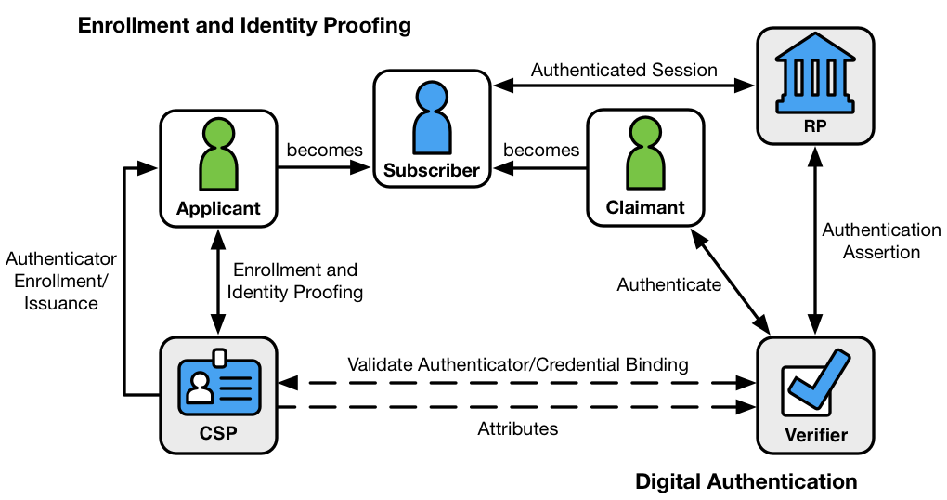
Authentication a la NIST
Verifying digital identity
Asserting the fact of your identity
Not just simple identification
Authentication Factors
What you know
What you have
What you are
Where you are
What you can do
Potential others
Strong Authentication, as defined by NIST, always requires at least two of these.
Graphic from NIST Special Publication 800-63-3
49

Slide 50

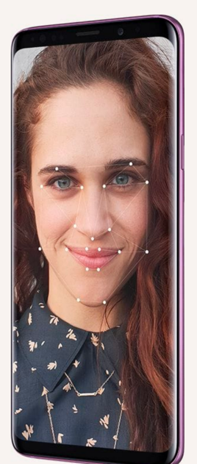
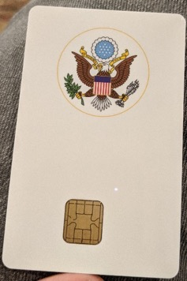
Authentication Factors
Username and password
Digital Tokens
Hardware (Cards and dongles of various types)
Software (app on PC, phone, watch, or ?)
Message-based
Biometrics
Samsung Intelligent Scan
Apple FaceID
Touch ID / Fingerprint
Mouse movements / keystroke timing
Other scarier ones?
50
Notes:
Bank balances?
Mothers maiden name?
Microdeposits

Slide 51
Authorization and Accounting
Often integrated with Authentication as in RADIUS into “AAA services”
Authentication is who you are
Authorization is what you’re allowed to do
Accounting is what you did
How might a bank use this process to protect resources?
What might an examiner learn from these logs?
“Who’s Matt?”
“Hi, I’d like access”
“Can I grant access to Matt?”
User Profile
Client
NAS
AAA Server
(looks legit)
“Here I am.”
“Hey, I know you!”
“He’s Okay.”
“Here’s his A&A”
Resource
51

Slide 52
Zero-Trust Network Access (ZTNA)
A small but important digression!
Note: Nothing in the previous example considered location
No “trusted” or “untrusted” locations or zones
No firewalls, no safe or unsafe networks
This will be one aspect of almost all future network access
ZTNA is defined in NIST SP 800-207
Some of your homework tonight is to have a look at it!

Slide 53
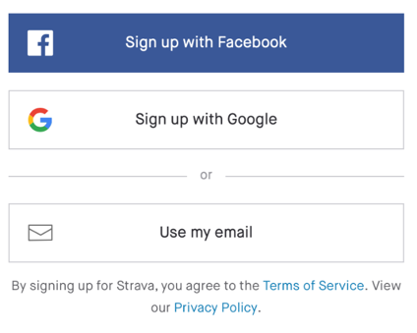


Authentication Protocol Operations
Protocols
PAP and CHAP – the first generation of simple authentication
RADIUS and Diameter – full AAA services provided by NAS servers
EAP – 802.1x, part of WiFi and Ethernet
Kerberos – Used in Windows and elsewhere
OpenID
Oauth
Trusted third parties as ID Brokers and more
Google Sign-In
Facebook Connect
Log in with Apple
What privacy issues do these third-party authentication schemes raise?
RADIUS
53

Slide 54
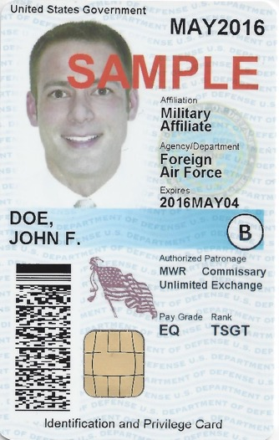
How and when do you authenticate yourself?
We can provide digital proof of identity in a card or chip
Many governments use one for access to services, to prove citizenship, and to allow digital signatures.
The US does not do this, leaving eIDs to organizations.
Social Security Cards aren’t electronic.
What you think of this is up to you.
FDIC employees have a digital ID card with multiple uses
Do you have cards? Tokens? What kind are they?
Do you have other methods of ID and Authorization?
Must you ever prove who you’re not? Through what process?
What’s being authenticated? You? Your computer? Your card?
Can you imagine other authentication mechanisms?
Have you used Google or Facebook authentication?
What do you think of the current trend towards MFA?
54

Slide 55


Certificates
A form of digital ID in an encrypted file (X.509)
Crucially, it contains a public key and your ID info
Information in a certificate is guaranteed by a certificate authority (CA)
Certificates are issued by companies like Verisign, Entrust, Thawte, Digi-sign, etc. You can also create them yourself!
All certificates have the same basic level of “trust”
So users must be aware of the source of their CA’s authority
Different applications use different Digital Certificates
SSL VPNs (for HTTPS websites)
Software Signing (to prove your software is from the source you trust)
Client IDs (to authenticate individuals to each other or to some organization)
A certificate is only as trustable as you think it is
Just seeing “https” only proves so much.
Please trust that you can safely conduct an SSL session with me.
55

Slide 56
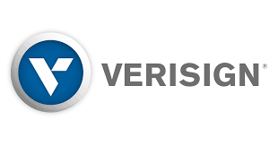
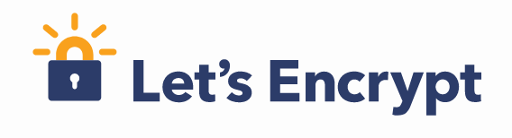


Certificates in Daily Use
Expiration – certificates have a lifetime
Have you ever seen one that’s expired?
What happens when you encounter one?
Roots, CAs, Self-signed certs
How do you know whom to trust, and how much?
What’s the difference between Verisign, Digicert, and Let’s Encrypt?
Questions for Exams
What certificates do you have, and how did you get them?
Are they all legitimate and authentic? How do you know?
Do you have measures in place to ensure validity over time?
Demo on Boingit.com
We’ll see how to validate a certificate via several different methods.
Now do it yourself on a site of your choice that matters to you.

Slide 57
Zero Trust Architectures again
No real “inside” or “outside” the network.
Every person or device requesting access must strictly authenticate.
Usually “authenticate” here means to each application.
Assumes attackers exist both “inside” and “outside”.
Not a product, more a philosophy and set of guidelines.
Related concepts include:
Least-privilege access.
Microsegmentation.
Strong authentication using MFA.
Many security solutions tout adherence to ZT models
But it’s difficult to conform to guidelines that aren’t standards.
Still, the principles are useful in designing and evaluating / examining.
The FFIEC Handbook suggests “multiple layers of access controls.”
(Not zero trust exactly, but getting there…)

Slide 58
Should Governments be Involved with All This?
We’ve asked before if the Internet should be more regulated.
Should the government provide a digital ID? Why or why not?
Should the government be the “Top-level CA”?
Is the government involved already? If so, how so?
58

Slide 59
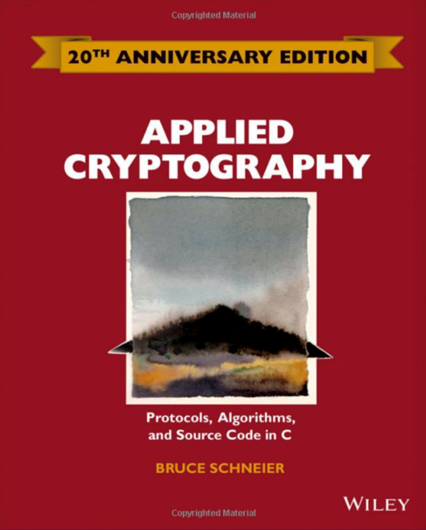
Cryptography
Cryptography is the study of codes
You’ve probably heard about the huge role it played in WWII and other more modern conflicts
In our modern internet context, it concerns keeping digital information secret
It’s often called “crypto” but don’t confuse this with Blockchain, or Bitcoin or other cryptocurrencies
The basics are simple, but deep down there’s lots of techno math magic as you’d expect
We’re not going there…well, maybe just a little
This book should be your reference if you want to know more
I strongly recommend anything from Bruce Schneier, including his blog: schneier.com
Also good is Simon Singh’s The Code Book
59

Slide 60
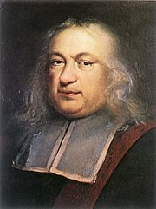
A Little VPN Math
So far, we’ve only hinted at the computing behind VPNs.
We’re not going too deep, but we must grok how they keep our information safe.
Most VPN technology uses relatively simple algorithms running really fast, thanks to Moore’s law.
There’s also some real rocket science. I’m happy to discuss this part offline or point you to resources.
A key is applied to data to (among other things) encrypt or decrypt it.
Relatively small keys can provide very complete protection.
Keys as short as 128 bits protect US Government SECRET information.
Messages thus encrypted are practically un-crackable, and that’s a short key.
If you really like math, crypto is your thing
The “big concept” in cryptography is prime factorization.
To calculate 19 x 31 = 589 is easy, but harder to find the prime factors of 589.
If you want to go further in this topic, read Schneier!
There are many other resources on the web, like Khan Academy: https://www.khanacademy.org/computing/computer-science/cryptography/
60
Notes:
Pierre de Fermat

Slide 61
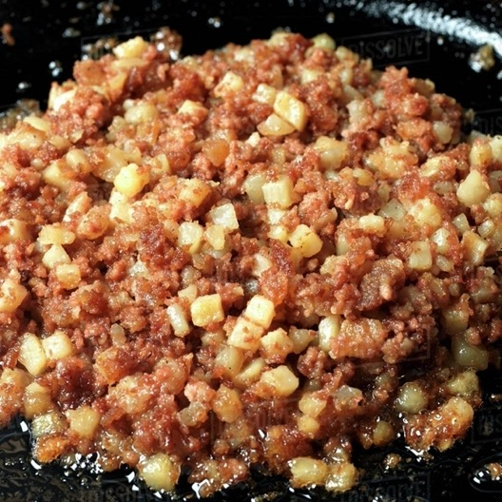
Hashes
A hash is a one-way cryptographic function.
They are essential for authentication and the public key infrastructure
You’ve (sort of) seen them before in IP and Ethernet checksums and CRCs.
Modern, famous hash algorithms include MD5 and SHA-1.
State of the art is HMAC, used in IPsec, TLS, and other protocols.
Hashes are also important because they can work as fingerprints.
61

Slide 62
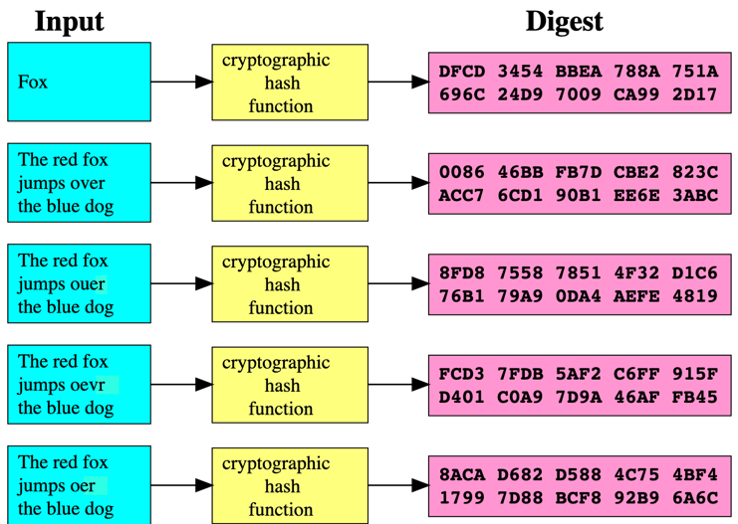
Hashes can confirm that something is as it was
Useful in cryptography, specifically in authentication, “fingerprinting” and digital signatures
Impossible to retrieve the source data from the hash digest (the output, or result.)
Also impossible to know even the length of the original message.
Changes in the input create random -seeming changes in the output, which keeps things obscure.
But the same input twice always gives the same digest.
62

Slide 63
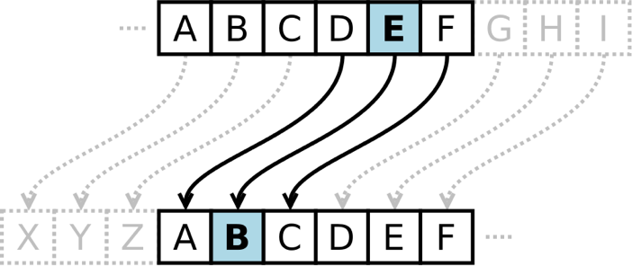
Encryption
Substitution, Transposition, and other Fun Stuff
ROT13
Caesar Ciphers - J mpwf WQO dmbtt bu uif GEJD!
One-time pads
Algorithmic Ciphers
One-way Functions
Remember hashes?
Symmetric Functions
Something we can un-do!
Modern ciphers in daily use include:
RC4
3DES
AES
These are PDS.
63

Slide 64
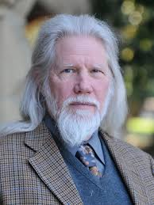
Keys
Cipher Keys are the big problem modern encryption must solve
Key length is a primary determinant of strength
Symmetric keys (AES, Blowfish, 3DES) can be quite short, 128 to 256 bits.
Asymmetric keys (DSA, RSA) must be longer, 1024 to 4098 bits.
Longer keys are much more processor-intensive, so more “expensive”
Key Distribution methods, each with pros and cons
Pre-Shared Keys – easy to understand, hard to scale in space or time
Public Key Infrastructure – combines long and short keys
A bit harder to understand than PSK.
Use asymmetric keys to securely distribute symmetric ones!
We’ll take a look at this next.
Read up on Whitfield Diffie if you’re so inclined.
64

Slide 65
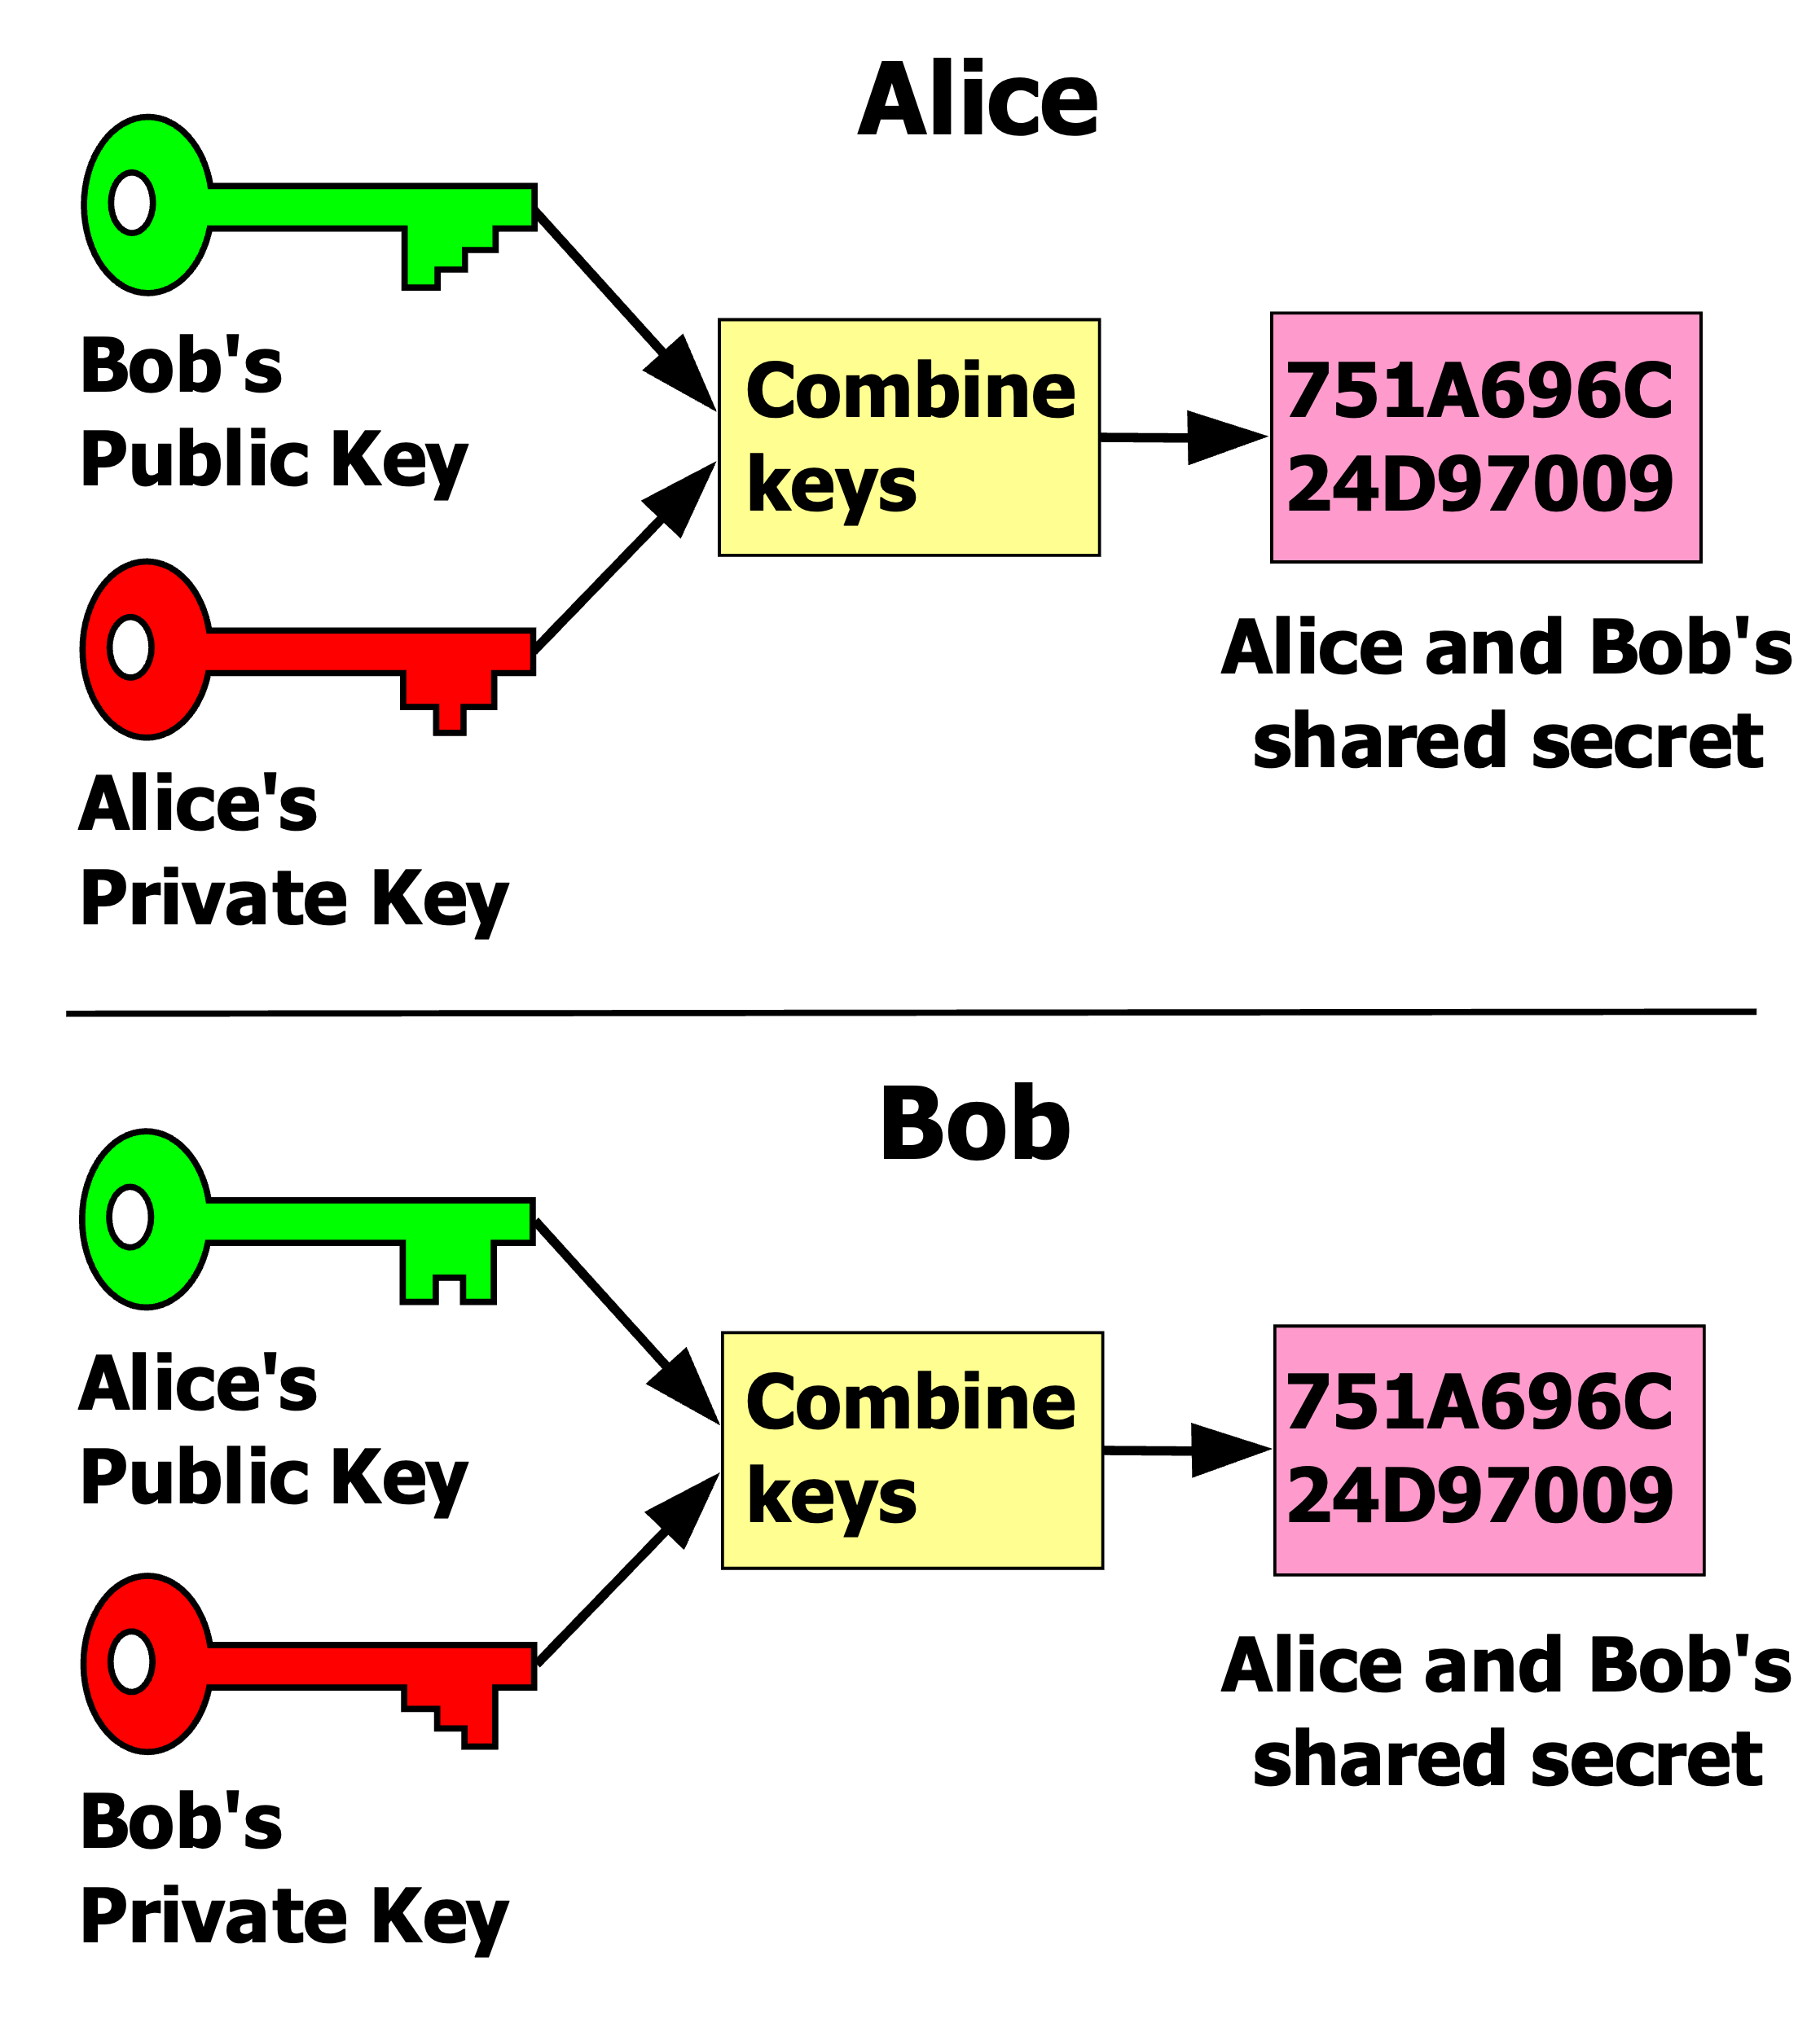
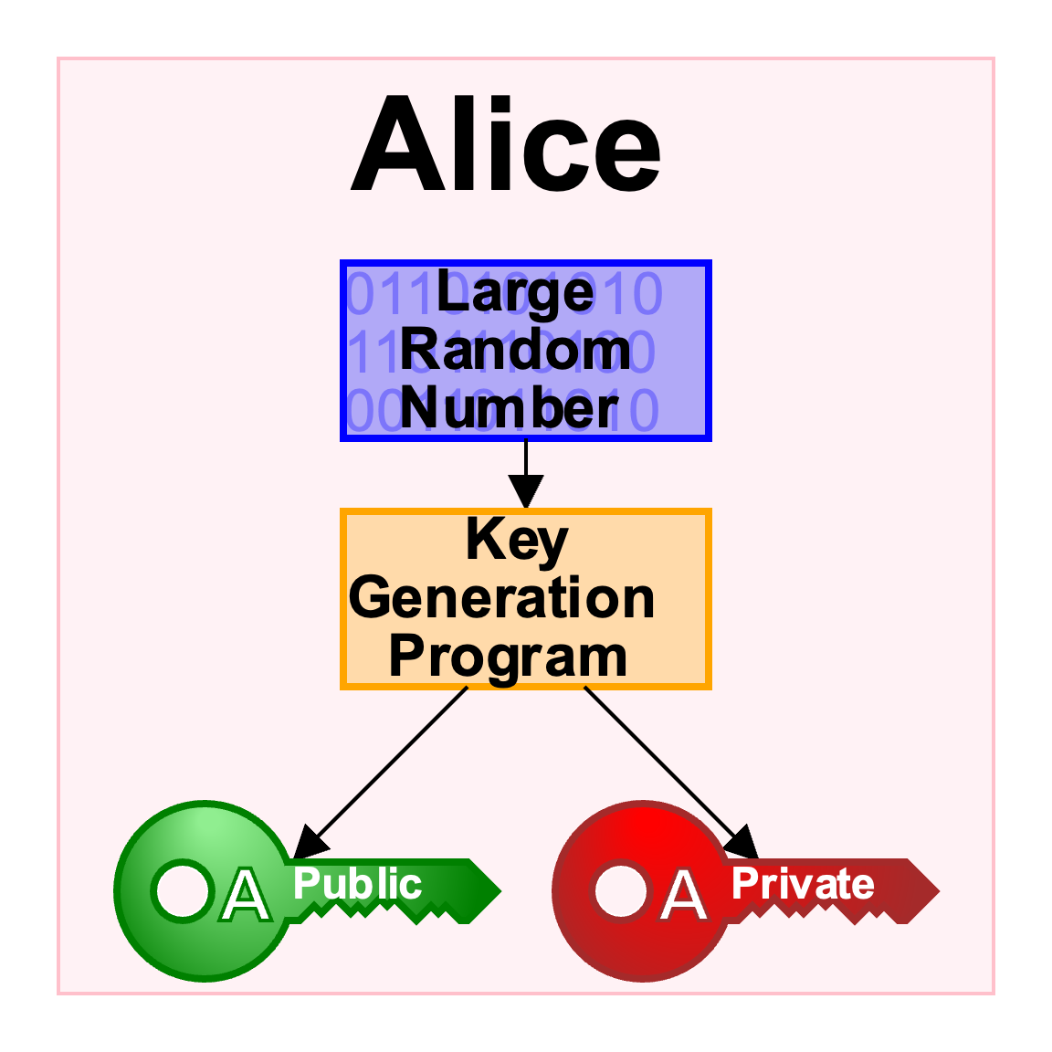
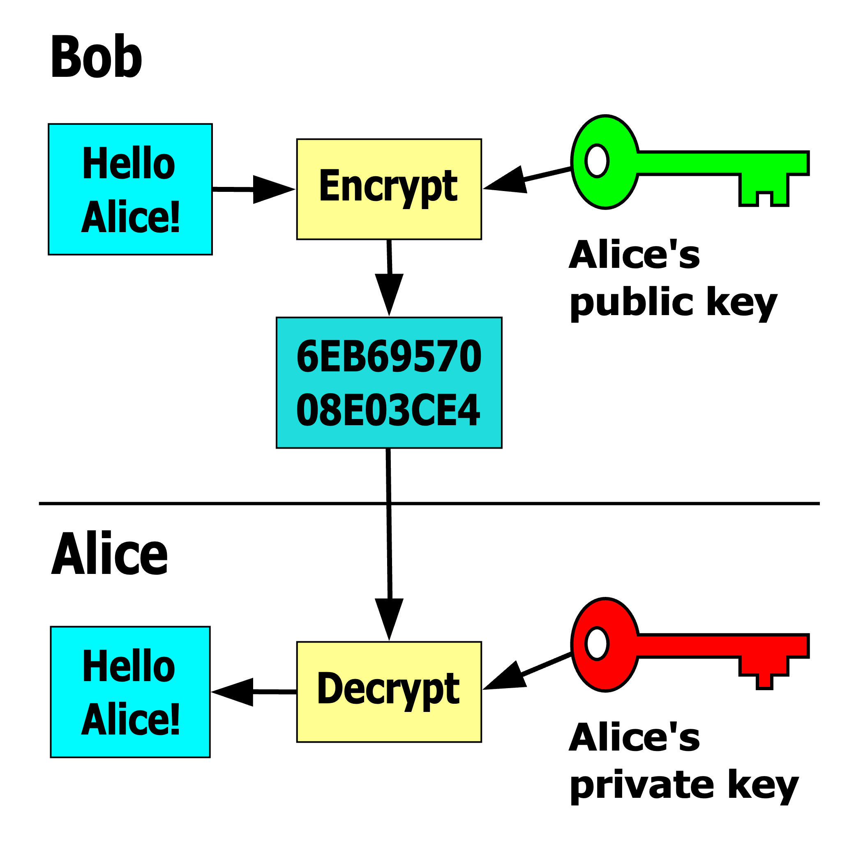
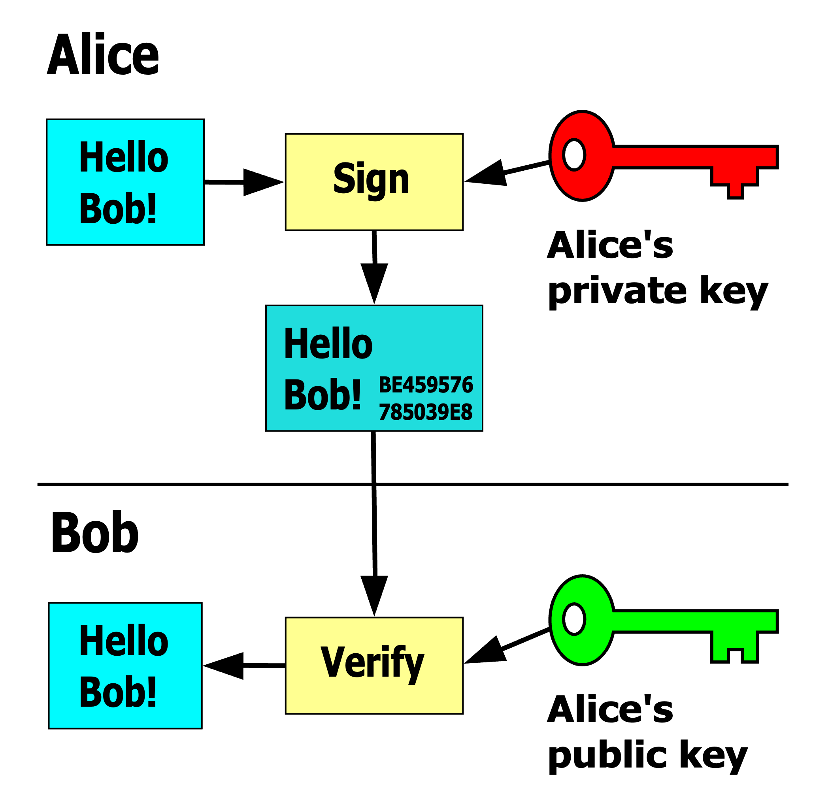
Public Key Infrastructure
Generate a key pair
Bob encrypts for Alice
Alice and Bob can keep a secret
Or just sign a message

Slide 66
Public and Private Keys
Demo of some aspects of key operations
Remote login
Keypair creation
Option to try it yourself (with help)

Slide 67

Cryptanalysis and Cracking
We assume that modern VPNs are bulletproof and uncrackable.
This is probably (almost entirely) true.
Then again, there are the WWII stories of Enigma and Purple…
Known weaknesses are mostly operational ones:
Poor design
Poor execution
Poor management
Unknown weaknesses are, well…unknown.
No one really knows what the spooks (friendly or otherwise) can really do regarding decryption.
Some say the NSA can decrypt https on the fly. But they’re the NSA.
And they’re not bad guys, right?
Right?
What about the MSS, FIS, MOI, RGB, or other TLAs?
Quantum computing could change all this but is likely pretty far away.
67

Slide 68

Backdoors
Perhaps someone holds a “master key” for your VPN
Unless you can examine and understand the code and math, you can’t know if there’s a backdoor
There are two ways we comfort ourselves
Open Source code review.
Trust in your Vendors.
Key escrow is a form of sanctioned backdoor whose use is controversial.
Who has access, and under what circumstances may they give up keys?
BitLocker and Filevault are two such services with commercial traction.
Apple is very publicly against such an idea.
The courts will have to weigh in here.
Once again, the question is “Who can you really trust?”
68

Slide 69

Activity: Authentication of the Future
Working in your group, try to imagine how AAA will work in 2050.
How many and what kind of factors?
Biometric, behavioral, genetic, brainwaves?
What kind of problems must be conquered before we can use your new system?
Is banking a special case for Authentication?
Is something different about financial information that requires a different approach?
Report your discovery to the class.
Bonus points for outlandish, crazy solutions.
When you were in high school, would you have believed e.g. PKI?

Slide 70
Let’s do this instead:
Go to class.hill.com and see the exercise there
Each group has a topic
Take 20 mins to research and discuss in your group the assigned tech/solution/protocol/company/thing
I suggest:
Everyone read the link and/or related materials (10 mins)
Have a chat about what you think and make some notes (10 mins)
But hey, it’s up to you!
Come back and tell us all about it

Slide 71



What did you think?
Pros:
Cons:
Pros:
Cons:
Pros:
Cons:

Slide 72
Chapter Summary Questions
What is a proxy server, and why are they important?
What is AAA? Tell us about it.
Name some examples of AAA functions and describe in broad terms how they work.
What are certificates, and what is their role in network security?
Explain PKI and the attendant technologies that make it work.
Can today’s encryption keep our banking data safe?

Slide 73
VPN Applications and Architectures
Chapter 5

Slide 74

Chapter Objectives
Consider several different types of VPN.
Learn important and widely-deployed implementations.
Understand some limitations of VPN access.
Discuss some solutions or technologies related to VPNs.
Differentiate between cryptographic and separation-based VPN technologies.

Slide 75
Types of VPN by Use Case
Site-to-Site
The classic VPN case, connecting two or more private networks over a third non-private one while preserving privacy.
Can be used as an intranet or a “partner-net” (e.g. access to a public cloud.)
This is one way core service providers offer secure access to banks.
Remote Access
Connecting a single computer or device to a private resource over an intermediate non-private network.
Secure Internet Access
Access to the Internet over a VPN to hide information and location.
APIs
Built-in VPN capability for easy access by applications.
This can make VPNs “just happen” for applications that need it.
75

Slide 76
Encrypted VPN Implementations
There are many types of encrypted VPNs, here are just a few of the most widely-used:
PPTP and L2TP
IPsec
SSL/TLS
DMVPN
OpenVPN
Embedded VPNs
Implementations are productized by hardware, software, and service/cloud vendors.
Usually when you hear a product name, it’s (mostly) one of the above protocol implementations.
The vendor sometimes adds some special stuff, but often not much more than marketing.
Many based on open-source software, sometimes with hacks.
Nobody should trust a proprietary VPN.
76

Slide 77
PPTP and L2TP
Point-to-Point Protocol
The first VPN protocol from before VPNs existed.
Supported on everything since forever
Limited to 128-bit encryption
Unstable? Unsecure?
Layer 2 Tunneling Protocol
Child of Cisco and Microsoft
“A better VPN protocol”
Much more complex point-to-point replacement for PPTP
256-bit encryption
Very widely supported
Both protocols supplanted by better methods.
Still commonly deployed by banks and elsewhere.
Application
Presentation
Session
Transport
Network
Data Link
Physical
77

Slide 78
IPsec
Internet Protocol Security
Flexible (so complicated) architecture
A suite of protocols that provide
Authentication (AH headers)
Encryption (ESP headers)
Security Associations (SAs)
Can operate in two modes
Host-to-host (transport) mode for device access
Network-to-network (tunnel) mode for WAN-building
Pros:
Venerable, flexible, widely supported, part of many solutions.
Cons:
Complex to configure and use, (too) many different knobs to twist.
Application
Presentation
Session
Transport
Network
Data Link
Physical
78

Slide 79
SSL and TLS
Secure Sockets Layer and Transport Layer Security
Do you remember what sockets are?
TLS is essentially the “new version” of SSL
I told you the OSI review was going to be useful!
Client/Server and sometimes Server-Server
Linked with HTTPS (HyperText Transport Protocol Secure) for the web
Many configurable parameters for wide applicability.
SSL and TLS are less VPNs themselves than VPN components.
But they’re very automatic for the limited roles they play.
Application
Presentation
Session
Transport
Network
Data Link
Physical
79

Slide 80
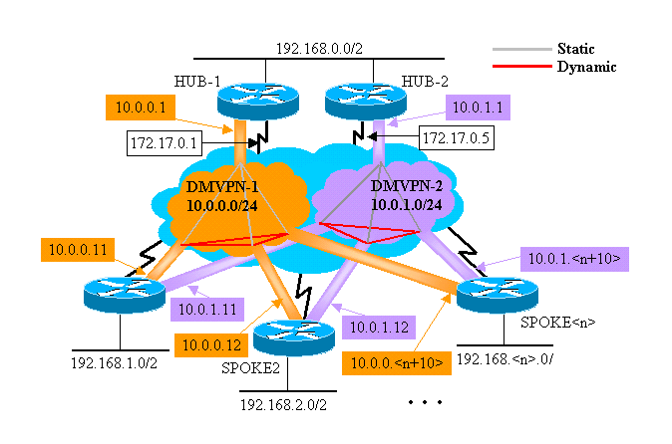
DMVPN
Dynamic Multipoint VPN
The first widespread “automatic” multi-site VPN technology.
A Cisco-centric standard for a tunneling VPN that auto-deploys and auto–configures.
Available from some other equipment vendors.
Relies on common protocols like GRE, NHRP, IPsec, and standard routing protocols.
AES encryption usually employed.
Pros:
Well-understood because it’s widely-deployed.
Old Cisco-heads are very comfortable with it.
Cons:
Tedious and error-prone manual config despite its name.
Doesn’t scale well for large networks.
80

Slide 81

OpenVPN
Open-source project behind many commercial solutions
Widely deployed for cloud access at AWS, Azure, GCP, Digital Ocean and others
Many different business and consumer options.
Also offered as a service by OpenVPN.net
https://openvpn.net/ is the commercial offering.
Pros:
Open and well-understood by experts, therefore deeply trusted.
Cons:
Not a single-vendor solution so considered complex and incomplete by some.
81

Slide 82
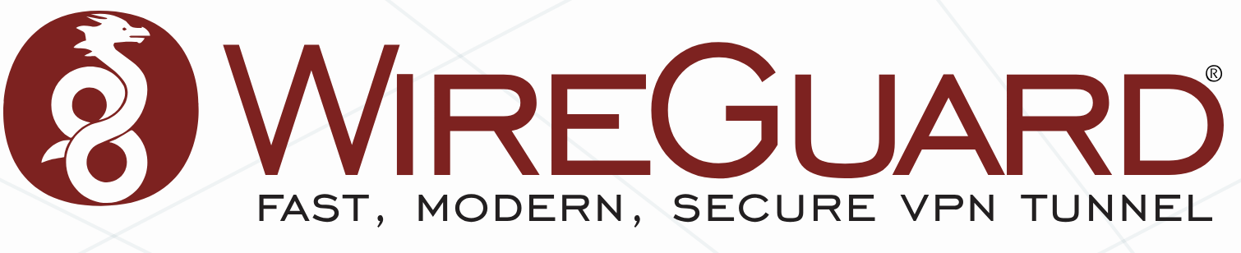
Wireguard
Open-source VPN software released in 2015
Intended to be faster and lighter than IPsec or OpenVPN
Uses UDP to carry all traffic
Incorporated in many commercial products as of 2020 or so
Services: PIA, NordVPN, Mullvad, ProtonVPN, others
Platforms: TailScale, Cloudflare
Also now natively part of many operating systems
While technically robust and widely deployed
Not yet FIPs-validated by NIST
Non-compliant though awesome
This will change, but when?

Slide 83



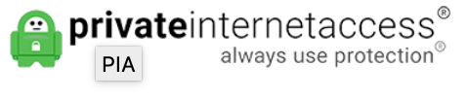
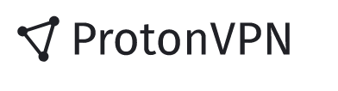

Internet Access Client VPNs
Many commercial products: TunnelBear, Mullvad, IVPN, ProtonVPN and many others
Most promise the same things
Keep your data safe!
Use the web anonymously!
Encrypt your information!
Clients for everything!
Tons of other great features!
It’s not that simple (it never is, is it?)
Read the deets before signing up
Consult reviews to choose
Use one of these in public and…well, all the time.
They protect data between you and the VPN provider, that’s it
But that’s quite valuable against some types of attack

Slide 84
VPN Limitations
If you haven’t noticed, VPNs are a complex topic with multiple gotchas.
There is immense confusion in the market, with many opposing agendas.
Security is a loaded and intimidating arena in rapid transformation.
There aren’t many “easy buttons” without compromise.
VPNs are great at protecting data in flight, less so in endpoints and at rest
There’s much better identification information than IP address.
If you log in, it doesn’t usually matter from where, you’re still you.
And even if you don’t log in, there are cookies, browser fingerprints
Legal protections also unclear
Mutual legal assistance treaties mean criminal activity isn’t protected overseas.
Not this again…

Slide 85

Embedded VPNs
ATMs are famous for being vulnerable to “card skimming” but
Cash Machine skimming doesn’t need skimming hardware.
Network-based attacks are possible with and without LAN access.
ATMs and other bank equipment should have embedded VPN software and/or hardware
But amazingly they sometimes do not.
ATM operating systems are usually based on Windows 7 or CE, or Embedded Linux
Windows CE is still the dominant force here!
Does the OS contain the VPN?
Is the VPN part of the application?
Independent ATM operators account for 60% of US ATMs
Less regulated than other financials.
Is this a bank liability?
Who pays when the machine gets hacked?
85

Slide 86

Topics related to VPNs with more to discuss
VPNs as a topic touch many areas of banking and networking, here are just a few:
Remote Access Gateways
Zero Trust Architecture
Split Tunneling
DNS Leaking
We can’t cover all of these in detail, but realize that simply saying “we have a VPN”:
Leaves a lot to the imagination.
Only addresses part of the problem.
May not solve issues that need solving.
Could be security theater.
Does someone at the bank understand the security picture?
And the role any remote access or VPN solution?
86

Slide 87

VPNs based solely on separation
MPLS, Carrier Ethernet, and other shared WANs
Usually provided as a service by telcos or other service providers.
Can be used to build WANs and provide access to the cloud.
Can even integrate Internet access, although that’s a risk.
Acceptable or not depends on many things.
Ethernet 802.1x vLANs, VxLAN, EVPN, GRE
Tunneling protocols used in networks everywhere.
Don’t include encryption or authentication unless explicitly added.
Do these solutions need cryptographic protection as well?
This depends on the infrastructure, topology, and connectivity.
It may also depend on the regulatory regime.
B
D
C
A
A
B
C
D
87

Slide 88

MPLS: VPN or not? “Secure” or not?
For 15 years or so, MPLS has been a very common type of connectivity for banks and others.
An MPLS network is by definition shared between different parties who usually are not even aware of each other’s existence, and who are unable to communicate with each other.
The bandwidth is shared but connectivity is not.
Some organizations, like the PCI SSC, have said “it depends on who built the network” but mostly agree that MPLS can be secure, and usually is.
Most organizations have not specifically ruled on this point.
Things to consider:
Are you worried about people listening to your phone calls? Why or why not?
Are you worried about people reading your email? Why or why not?

Slide 89
Activity: What to use where?
Work in a group at your table.
Consider the network diagram handout, note the topology and locations/resources/users.
What protocols do you think would be most useful for each application or location or use?
What would you need to know to determine that usefulness?
Which solutions or protocols have you seen before?
Consult provided exam topologies, or others if you have them.
Google the tech we’ve reviewed for clues.
Present your solution on a whiteboard, flipchart, or projected.

Slide 90
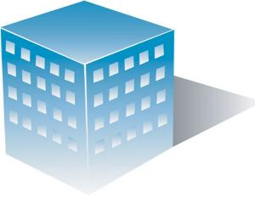



Exercise Topology
Bank HQ
How do customers securely access bank services?
How do the branches and HQ/DC interconnect?
How does the bank access the services it needs?
What other VPN considerations might there be?
PSTN/WAN
Internet
Branch C
Branch A
Branch B
Customers
Partners
Service Providers

Slide 91
Review of Wednesday
VPN Building Blocks
AAA
Encryption
Certificates
VPN Applications
Protocols and Solutions
Separation vs Encryption
Exercise Review

Slide 92
Chapter Summary Questions
Name several different types of VPN.
List the pros and cons of several important and widely-deployed VPN implementations.
Can you relate some limitations of VPN access?
What are some solutions or technologies related to VPNs?
What are some differences between cryptographic and separation-based VPN technologies?

Slide 93
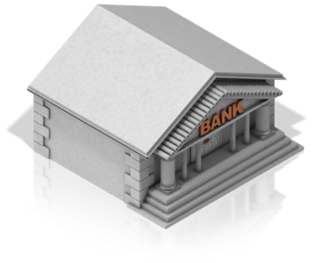

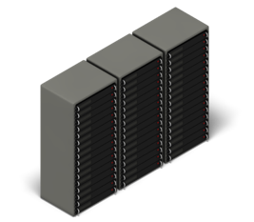



Split Tunnels
Internet
Considerations:
Security concerns from “back door” access
Cypher / key length adjustments in encryption
Improved tunnel routing / traffic selection
TCP tweaking
Different VPN Vendor?
New tech (SASE, AI, ML, ZTNA) in future

Slide 94
VPN Platforms and Products
Chapter 6

Slide 95
Chapter Objectives
Review some common VPN platforms and vendor solutions for:
Site-to-site networks.
Remote access of various types.
Remote desktop/administration.
Consider how VPNs interact with common deployments of:
Firewalls.
UTM platforms.
SD-WAN solutions.
Discuss some concepts related to privacy and encryption, such as:
TOR.
Blockchain technology.
Quantum cryptology and quantum computing.

Slide 96
Site-to-Site Solutions
AWS
Here are three ways to build a secure WAN
IPsec VPN (manual)
DMVPN (automatic)
SD-WAN (magic)
There are many other possibilities!
What if the Internet to the right:
Was hit by a big DDOS attack?
Wasn’t the internet? What could it be?
What would the implications of this be regarding:
Trust?
Cost?
Usefulness?
Would SD-WAN still be useful in that case?
NYC
Internet
KC
JH
ATL
96

Slide 97
Remote Access Solutions
Remote access to what?
An entire bank LAN and/or its components?
A single PC or server for troubleshooting?
A single application, either on a server or in the cloud?
RA generally implies a client accessing another client or a server to either:
Control or access that computer and its data.
Used as an administrative node in a network or cloud.
As such, RA is a very powerful tool for good or bad.
As necessary as it might seem, it’s not used or allowed in other places.
Admins often have their own secret backdoors.
That said, SSL/TLS plus HTTPS form the core of many good RA solutions.
Their safety depends on (like everything else) guidelines and management.
Their auditability depends on logging and testing and record-keeping.
97

Slide 98
Remote Desktop or DaaS
A special case of remote access allows admins or supervisors to:
“Take over” or ”Take control” of users’ clients, or servers, or anything else.
Remotely administer network or other equipment or services.
RD is like RA plus some interface application.
Usually tied to the desktop OS.
Windows and MacOS have their own functionality.
Many vendors compete with lots of features:
Cloud-supported access.
Vendor-agnostic support.
Clientless (web) access.
Big names in the space include:
Connectwise.
Logmein.
RemotePC.
98

Slide 99
Remote Access examples (beyond basic VPNs)
Virtual Desktop Infrastructure (VDI)
Citrix Virtual Apps and Desktops – The legacy standard in banking.
Microsoft Azure Virtual Desktop (AVD) – MS is everywhere, so...
VMware Horizon – For VMware-heavy infrastructures.
Remote Monitoring and Management (RMM) for Vendors
Connectwise Control
LogMeIn
Secure Web Portals & Application Gateways
F5, Okta, Duo, Zscaler provide various identity and other web svcs
Big trend is towards zero-trust architectures.

Slide 100
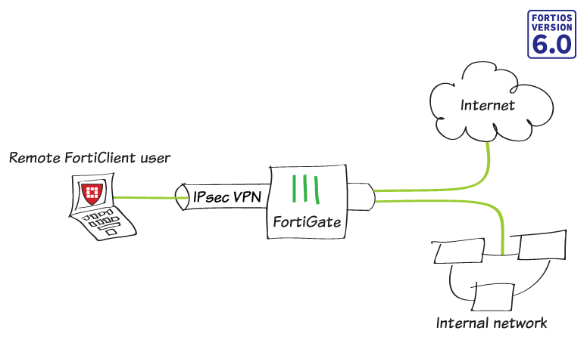
VPNs and Firewalls
The “Firewall” used to just protect the bank perimeter from bad guys on the Internet.
They are much more than that now.
Two kinds of VPN may be supported:
Internet site-to-site gateway role
Remote access role
As in the example to the right.
Client may be required.
As UTM becomes more universal, this type of support is becoming almost expected.
This might be where split tunneling would provide different types of access.
100

Slide 101
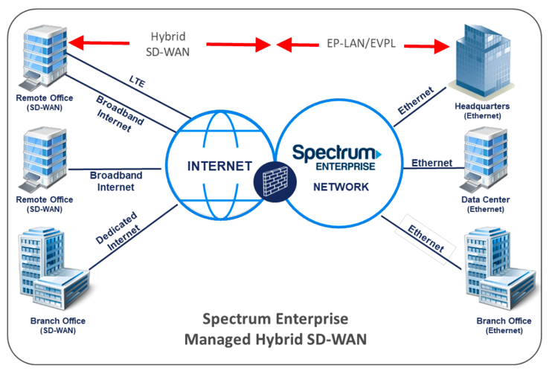
VPNs and SD-WAN
A big part of SD-WAN’s role is to create site-to-site VPNs
It also implies split tunneling and internet access.
The “SD” part means SD-WAN can fill many other roles
Secure Internet access
“Real” WAN integration
Cloud access
WAN optimization
Network intelligence and visibility
In 2019 SD-WANs aren’t yet widely deployed by banks, but expect to see them a common solution soon.
101

Slide 102
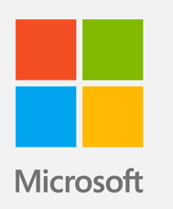
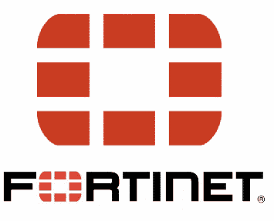
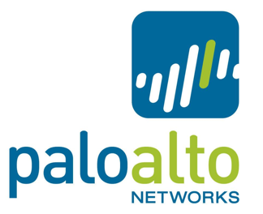

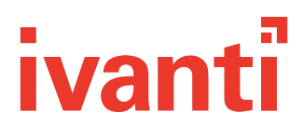
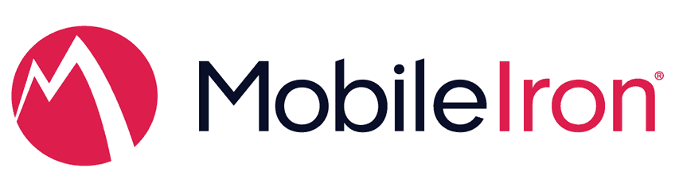
Vendors and Boxes, Software and Services
Many companies provide “VPN” solutions:
Microsoft Always On VPN
Fortinet FortiClient etc
Citrix VDI
Avanti MobileIron
Palo Alto GlobalProtect
This is just a small sample, and their products are similar, but they differ in important ways.
We’re about to find out how.
1
2
3
4
5
102

Slide 103

Exercise: Remote Access
Each table research and discuss one of the vendor solutions on the previous slides
Pick a scribe/director
Choose a product or have one assigned by the instructor
Work together to research and create a short report on the product
Strengths/Weaknesses/Opportunities/Threats (SWOT) analysis
Suitability for a typical bank of your acquaintance
Present your findings to the class
Pay particular attention to Strengths and Weaknesses of the solution, such as
Adoption
Net Promoter score / recommenders
Cost
Complexity
Security
103

Slide 104
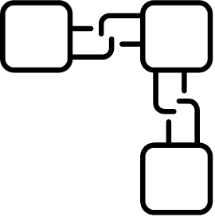

VPN-like or VPN-related technology
TOR: The Onion Router.
Open-source, fully secure “private access to the uncensored web.”
Much more “private” than just a VPN, but not a panacea.
Probably more useful to crooks than banks for now.
Important to understand as a concept and tool.
Blockchains.
Most famous for how they power Bitcoin and other cryptocurrencies.
Many less disruptive but still profound potential uses.
Quantum cryptography and quantum computing.
Could be real game-changers.
Mostly a science experiment for now.
104

Slide 105
Chapter Summary Questions
Name some commonly deployed VPN solutions for:
Site-to-site networks.
Remote access.
Remote desktop.
Discuss how VPNs interact with:
Firewalls.
UTM platforms.
SD-WAN.
What is the difference between a VPN and TOR?
How might widescale use of blockchains change Internet commerce?
When quantum computers are easily available, will encryption still work?

Slide 106
VPNs in the Financial Industry
Chapter 7

Slide 107

Chapter Objectives
Determine VPN effects on risk identification, measurement, mitigation, monitoring, and reporting.
See VPNs in the context of bank network controls.
Consider applications for VPNs in bank environments.
Learn ways in which VPNs may introduce (and lessen) risk to banks.
Finance-Specific Threats and Vulnerabilities
Learn the roles of FIPS, NIST, and other groups in determining VPN solutions.
107

Slide 108
Who’s in Charge?
Agencies who regulate remote access
Federal Financial Institutions Examination Council (FFIEC)
Office of the Comptroller of the Currency (OCC)
Federal Deposit Insurance Corporation (FDIC)
Federal Reserve Board (FRB)
National Credit Union Administration (NCUA)
Regs from them and others
FFIEC Handbook(s)
FFIEC Remote Access Risk Management Guidance
GLBA Safeguards Rule and Guidelines
Bank Service Company Act

Slide 109
Risk Management Expectations 🛡️
Regulators might expect banks to have:
Risk assessments specific to remote access
Access controls: least privilege, time-limited sessions
Monitoring and audit logging
Network segmentation (e.g., remote access restricted to specific zones)
Incident response plans for breaches involving remote access

Slide 110

Hmm...a VPN/RA-specific Risk Assessment?
What would that look like?
Would you:
Create it yourself?
Pull from the FFIEC handbook?
Consult the BSCA?
Provide it to the bank?
What controls might be implemented with it in mind?
Administrative?
Outsourced?
Technical?

Slide 111

VPNs, Remote Access and Risk
Any information security program has a Security Culture.
VPNs and RA are, by some measures, inherent deception.
How might that influence culture?
VPNs allow one to manipulate:
What their role is.
Who they are (sometimes.)
Where they are.
What they’re allowed to do.
With this great power comes great responsibility.
The good news is that VPNs can help with Security Culture.
The bad news is that without the proper risk management processes, they can be very dangerous.

Slide 112

VPNs as Bank Network Controls
FFIEC network controls depend in part on establishing zones.
Trusted (inside)
Untrusted (outside)
VPNs often puncture those zone borders to traverse zones.
The effect on perimeter security considerations should be obvious.
This is one reason why zero-trust architectures and “defense in depth” are important design elements.
The astute examiner will consider these facts during examinations.
FFIEC also suggests maintaining accurate network diagrams.
VPNs and other virtual elements can make this very difficult.
Even network admins and IT staff struggle with this.
Examiners must ensure they understand what’s presented to them.
As you’ve learned, “We protect that with a VPN” means nothing by itself.

Slide 113





The Elements of “Remote Risk”
Reporting
Measurement
Identification
Mitigation
Monitoring

Slide 114
The Elements of “Remote Risk”
Identification
Harder to ID because harder to find.
Effective controls exist but must be correctly applied regarding AAA and access control.
Measurement
VPN control points include concentrators, gateways, and software – all of which produce logs.
Mitigation
One might say this is the whole point of VPNs – when correctly applied.
Monitoring and Reporting
Like measurement, these are usually a function of the control point.
Logs are the most valuable control points here.

Slide 115

Protecting Banks and their Customers
Security at multiple layers
Application
Network
Cloud
Infrastructure
Threat Intelligence
Logs
Audits
115

Slide 116

Fintech is changing the picture
New Roles, New Threats
As core banking shifts, the threats do too
Newer, less “core” functions probably more at risk
116

Slide 117
The End of VPNs?
Critical Flaws of the Traditional VPN Model:
VPNs often grant access to everything.
Once authorized, users typically have complete access to the authenticated network.
VPNs are too simplistic.
In a world where the physical perimeter is no longer relevant, they are unable to keep up.
VPNs provide static, perimeter-based security.
This is ineffective when user context and security threats are ever-changing.
VPNs are a siloed solution.
Ultimately, VPNs are only useful for remote access by remote users. They don’t help organizations secure on-premise users or on-premise networks.
Gartner’s Continuous Adaptive Risk and Trust Assessment (CARTA) solution might help.
Forrester and many vendors have similar ideas.
It’s difficult to dislodge ubiquitous and useful solutions like VPNs.
A post-VPN world is probably far off.

Slide 118
Exercise: Five Questions
What kind of remote or VPN access do you allow?
What methods are used?
Who can use them, and for what?
Does the bank connect sites with a VPN?
Again, what kind and how implemented?
Do you have an Intrusion Detection System?
How is that implemented?
Is it capable of defending against RATs?
How does the bank use digital certificates?
Who designs, implements, runs, and maintains all this stuff?
These are just some starting ideas. Your group should discuss, perhaps add some, and pick a maximum of five.
118

Slide 119
Exercise: Five Questions - guidance
Writing anything by committee is hard!
Probably best to start with an outline
What 3-5 topics do we want to ask about?
How deep will we go on each?
These are just some starting ideas. Your group should discuss, perhaps add some, and pick a maximum of five.
119

Slide 120

Exercise: VPN Design
Underhill Community Bank wants to securely connect its three branches to each other over their 1GB internet connections.
They also want administrator access to the internal bank network for management purposes
Their core banking, website, and customer access are handled by cloud services and are not part of this solution.
What questions would you asking in devising a solution for UCB?
What do you recommend?
120

Slide 121
Chapter Summary Questions
What effects do VPNs have on risk:
Identification.
Measurement.
Mitigation.
Monitoring.
Reporting.
How can one see VPNs in the context of bank network controls.
What applications exist for VPNs in bank environments.
Learn ways in which VPNs may introduce (and lessen) risk to banks.
Finance-Specific Threats and Vulnerabilities
Learn the roles of FIPS, NIST, and other standards bodies in determining VPN solutions.

Slide 122
VPN Case Studies and Examples
Chapter 8

Slide 123
VPN Case Studies and Examples
WAN Over Internet
Connect the Branches
Embedded VPNs (in ATMs and other Machines)
Core Banking Access
Remote Workers
Financial Account Access
Cloud Access VPNs
Avoiding Censorship
123

Slide 124
Let’s Wrap it Up!
Chapter 9

Slide 125

Review
125

Slide 126

Knowledge Check

Slide 127

Before we go…

Slide 128
Who We Are
Website: https://www.hill.com/
Company Information
Hill Associates, Inc. PO Box 9 Milton, VT 05468
+1.802.655.0940
info@hill.com
At Hill Associates, we excel at creating custom talent development programs. Our experts help identify and assess your needs, and create training and educational programs that exactly meet them. Though we specialize in information technology, we’ve strengthened companies and organizations in a wide range of industries for over 25 years. Let us help you create a world-class talent development program that moves your business forward.

